Slide 2
Learning Objectives
Explain how supply chain management is used
Describe customer relationship management systems
Describe knowledge management systems
Describe enterprise resource planning systems

Slide 3
Introduction
Enterprise system
Application used in all the functions of a business
Supports decision making throughout the organization
Enterprise resource planning system
Used to coordinate operations, resources, and decision making among manufacturing, production, marketing, and human resources

Slide 4
Supply Chain Management (1 of 4)
Supply chain
Integrated network consisting of an organization, its suppliers, transportation companies, and brokers
Used to deliver goods and services to customers

Slide 5
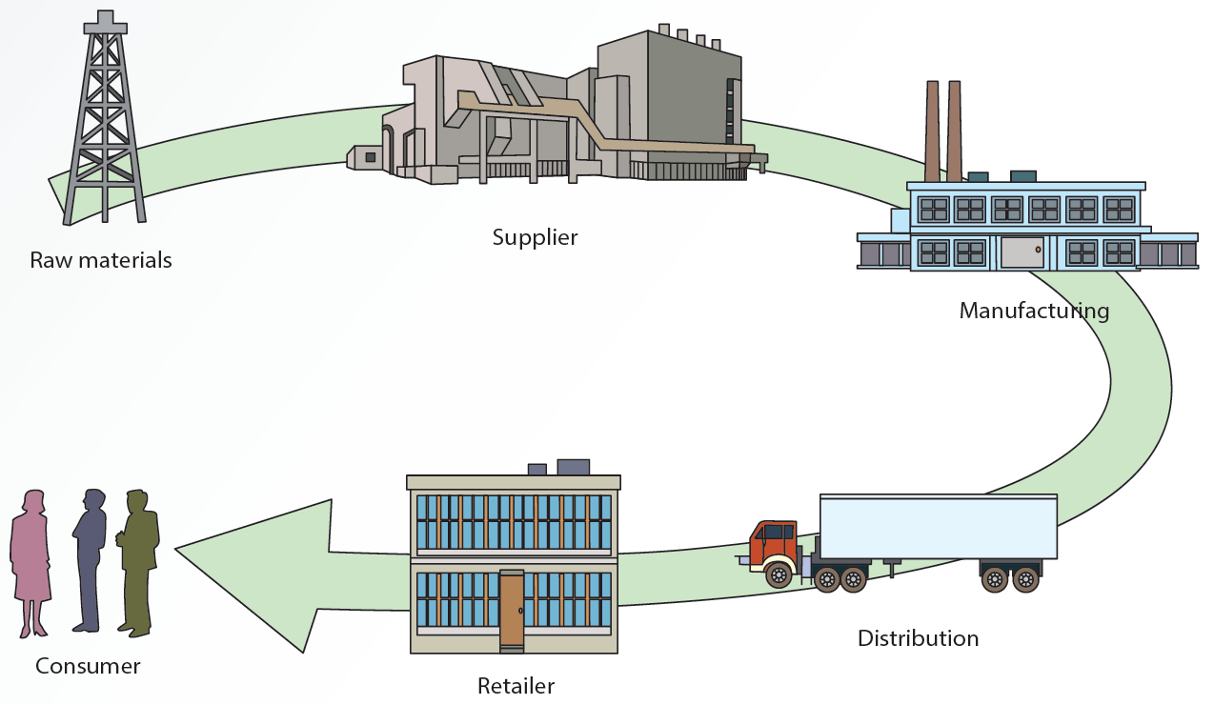
11.1 Supply Chain Configuration

Slide 6
Supply Chain Management (2 of 4)
Supply chain management (SCM)
Process of working with suppliers and other partners in the supply chain
Aim is to improve procedures for delivering products and services

Slide 7
Supply Chain Management (3 of 4)
SCM coordinates several functions
Procuring materials
Transforming materials into intermediate and finished products or services
Distributing finished goods to customers
Communication in a firm’s SCM system
Takes place among product flow, information flow, and finances flow

Slide 8
Supply Chain Management (4 of 4)
Key decisions in SCM related to manufacturing
Location, inventory, production, and transportation
Green logistics and green SCM
Growing trend

Slide 9
SCM Technologies
Major roles in implementing an SCM system
Information technologies
The Internet

Slide 10
Electronic Data Interchange (1 of 2)
Enables business partners to exchange information on business transactions
Expedites the delivery of accurate information
Web-based EDI or Open EDI
Using the Internet and Web protocols to transmit documents
Lowers cost of transmitting documents
Platform independent and easy to use

Slide 11
Electronic Data Interchange (2 of 2)
Drawbacks
Uses proprietary standards
Cost per partner is higher when the number of partners is small
Reduced popularity

Slide 12
Internet-Enabled SCM
Improves information sharing throughout the supply chain
Reduces costs for information transmission and improves customer service
Improves several SCM activities
Purchasing, procurement and scheduling
Inventory management and transportation
Order processing and customer service

Slide 13
E-Marketplaces (1 of 2)
Third-party exchange (B2B model)
Provide a platform for buyers and sellers to interact and trade more efficiently online
Help maintain a competitive edge
Provides opportunities for partnerships
Offers a single platform and reduces costs
Solves international time-constraint problems
Makes it easy to compare prices and products

Slide 14
E-Marketplaces (2 of 2)
An e-distributor is a marketplace owned and operated by a third party that provides:
Electronic catalog of products
Maintenance, repair, and operations (MROs) services
Fast delivery of a wide selection of products and services at lower prices
Assistance for companies to reduce the time and expense of searching for goods

Slide 15
Online Auctions
Bring traditional auctions to customers around the globe
Make it possible to sell far more goods and services than at a traditional auction
Based on the brokerage business model
Cost-effective for selling excessive inventory
Reverse auctions: sellers submit bids
One-to-many relationship

Slide 16
Collaborative Planning, Forecasting, and Replenishment (1 of 2)
Used to coordinate supply chain members through point-of-sale (POS) data sharing and joint planning
Goal is to improve operational efficiency and manage inventory
Advantage
Decreases merchandising, inventory, and logistics costs for all supply chain members

Slide 17
Collaborative Planning, Forecasting, and Replenishment (2 of 2)
Collaboration part of the process is the agreement between all supply chain partners that establishes how:
Data is shared
Problems with overstock are solved
Costs are shared or minimized
Exception management
Planning for handling unforeseen problems
Lessons learned can be used in future planning

Slide 18
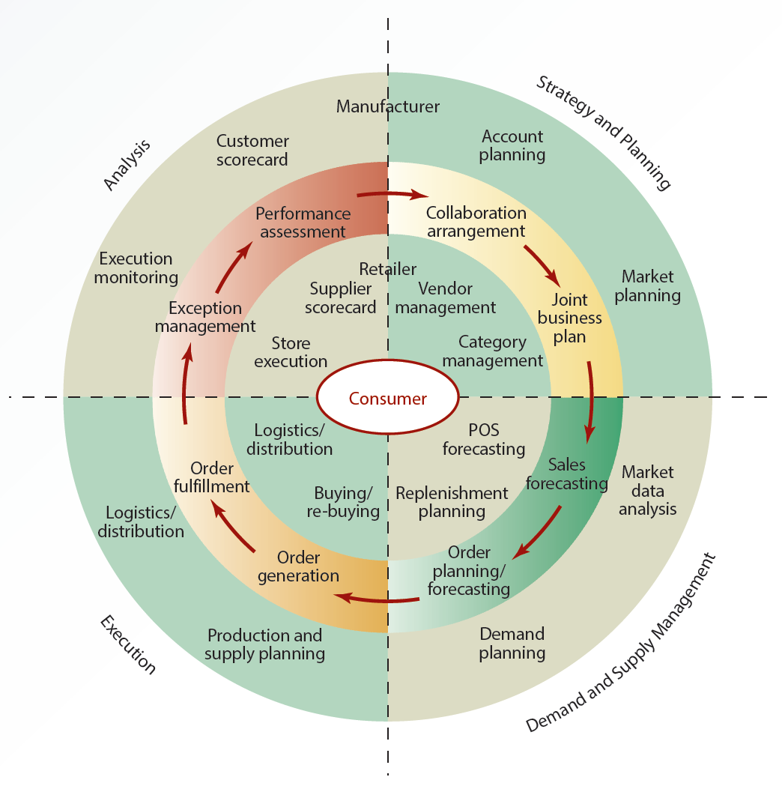
11.2 CPFR Process

Slide 19
3D Printing
Additive manufacturing
Making an object from a digital model
Plays a major role in SCM
Significant reduction in manufacturing times
Effectiveness in meeting customer demands
Elimination of the need to carry inventory
Quicker delivery of designs to the market
Efficiency in the use of materials

Slide 20
Drones
Specialized robot that is designed to fly and perform certain automated tasks
Available in various shapes and sizes
Vary in sophistication
Several SCM uses
Count, carry, and deliver inventory
Supervise animals in agriculture
Perform maintenance tasks in dangerous environments

Slide 21
Internet of Things (IoTs) (1 of 2)
Helps achieve several goals
Reduces inventory loss in warehouses or in transit
Reduces fuel costs
Ensures temperature stability during product transit

Slide 22
Internet of Things (IoTs) (2 of 2)
Manages warehouse inventory for out-of-stock inventory
Improves customer service and gathers BI regarding product usage

Slide 23
Customer Relationship Management (1 of 3)
Customer relationship management (CRM): processes a company uses to track and organize its contacts with customers
Improves services offered to customers
Uses customer contact information for targeted marketing
Helps organizations make better use of data, information, and knowledge to understand customers

Slide 24
Customer Relationship Management (2 of 3)
Marketing strategies focus on long-term relationships and include:
Identifying customer segments and a company’s profitable and loyal customers
Improving products to meet customer needs and customer retention
Provides a complete picture of an organization’s customers
Complex analyses on customer data

Slide 25
Customer Relationship Management (3 of 3)
Activities in a CRM System
Sales automation
Order processing
Marketing automation
Customer support
Knowledge management
Personalization technology

Slide 26
CRM Applications (1 of 2)
Implemented with one of two approaches
On-premises CRM
Web-based CRM
Software packages available for setting up a CRM system
Amdocs CRM, Optima Technologies ExSellence, Infor CRM, SAP CRM, and Oracle CRM

Slide 27
CRM Applications (2 of 2)
Features of CRM software packages
Salesforce automation
eCRM or Web-based CRM
Survey management
Automated customer service

Slide 28
Personalization Technology (1 of 5)
Personalization
Process of satisfying customers’ needs, building customer relationships, and increasing profits
Achieved by designing goods and services that meet customers’ preferences better

Slide 29
Personalization Technology (2 of 5)
Customization
Allows customers to modify the standard offering
Example: selecting a different home page to be displayed each time the Web browser is opened

Slide 30
Personalization Technology (3 of 5)
Requires gathering customer information
May affect customers’ sense of privacy
Implementation requires:
Internet and databases
Data warehouse/data marts
Data-mining tools
Mobile networks
Collaborative filtering (CF)

Slide 31
Personalization Technology (4 of 5)
Collaborative Filtering (CF)
Search for specific information or patterns using input from multiple business partners and data sources
Identifies groups of people based on common interests and recommends products
Works well for a single product category

Slide 32
Personalization Technology (5 of 5)
Collaborative filtering drawbacks
Needs a large sample of users and content to work well
Fails to make recommendations across unrelated categories
Application
Making automatic predictions about customer preferences based on similar users

Slide 33
Knowledge Management (1 of 6)
Knowledge management (KM) is a technique used to improve CRM systems
Identifying, storing, and disseminating “know-how”— facts about how to perform tasks

Slide 34
Knowledge Management (2 of 6)
Draws on concepts of organizational learning, culture, and best practices to:
Convert tacit knowledge into explicit knowledge
Create a knowledge-sharing culture in an organization
Eliminate obstacles to sharing knowledge

Slide 35
Knowledge Management (3 of 6)
Knowledge repository can be created by storing knowledge captured from experts
Can be accessed by employees when needed and used when new products are designed
Tracks how often an employee participates in knowledge-sharing interactions
Can be used to reward employees

Slide 36
Knowledge Management (4 of 6)
Tools and technologies
Groupware to create, manage, and distribute documents in an organization
DBMSs and data-mining tools
Decision support systems

Slide 37
Knowledge Management (5 of 6)
Contributions to an organization
Promote innovation by encouraging free exchange of ideas
Improve customer service by reducing response time
Increase revenue by reducing the delivery time for products and services
Improve employee retention rates by rewarding employees for their knowledge

Slide 38
Knowledge Management (6 of 6)
Chief knowledge officer (CKO) ensures:
Knowledge resources are collected, stored, and disseminated among key decision makers
Organization profits from knowledge resources
Return on investment (ROI) is maximized
KM and knowledge management systems
Processes

Slide 39
Enterprise Resource Planning (1 of 3)
Enterprise resource planning (ERP): integrated system
Collects and processes data
Manages and coordinates resources, information, and functions
Includes hardware, software, procedures, and input from all functional areas
Systems use a unified database to store data for various functions

Slide 40
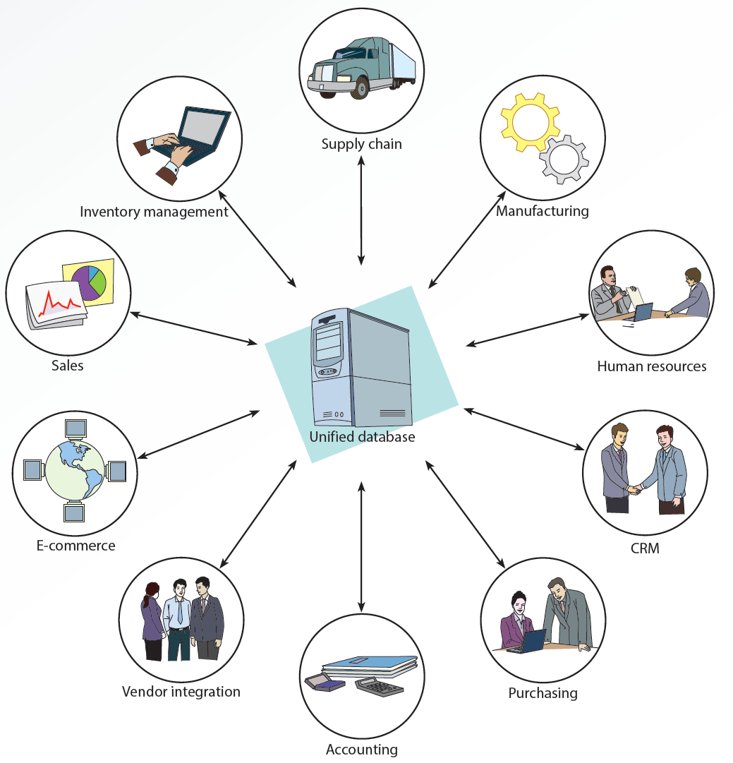
11.3 ERP Configuration

Slide 41
11.1 ERP Components (1 of 2)
Components | Functions
Unified database | Collects and analyzes relevant internal and external data and information needed by other functions
Inventory management | Provides inventory status and inventory forecasts
Supply chain | Provides information on supply chain members, including suppliers, manufacturing, distribution, and customers
Manufacturing | Provides information on production costs and pricing
Human resources | Provides information on assessing job candidates, scheduling and assigning employees, and predicting future personnel needs
CRM | Provides information on customers and their needs and preferences

Slide 42
11.1 ERP Components (2 of 2)
Components | Functions
Purchasing | Provides information related to the purchasing function, including e-procurement
Accounting | Tracks financial information, such as budget allocations and debits and credits
Vendor integration | Integrates information for vendors, such as offering automated downloads of data on product pricing, specifications, and availability
E-commerce | Provides B2C information related to order status and B2B information related to suppliers and business partners
Sales | Provides information on sales and marketing

Slide 43
Enterprise Resource Planning (2 of 3)
Benefits of a well-designed ERP system
Increased availability and timeliness of integrated information
Increased data accuracy and response time
Improved customer and employee satisfaction, planning and scheduling, supplier relationship, and reliability of information
Reduced inventory costs, labor costs, and order-to-fulfillment time

Slide 44
Enterprise Resource Planning (3 of 3)
Drawbacks
High cost
Difficulties in installation
Need for extensive training
Compatibility problems with legacy systems
Available as modules so organizations can purchase only required components
Keeps costs down

Slide 45
Summary
Supply chains exist in both service and manufacturing organizations
CRM systems help organizations make better use of data and knowledge to understand their customers
KM systems are used to improve efficiency of CRM systems
ERP systems use a unified database to store data for various functions

